Slide 1
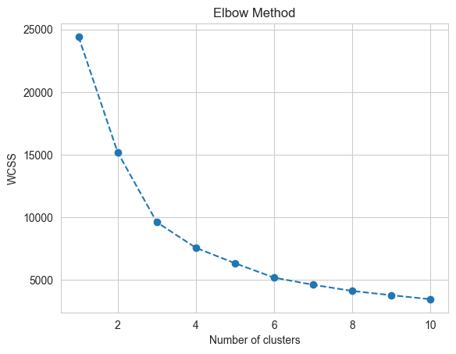
Clustering Evaluation – Elbow plots
Optimal clusters are at the point in which the knee "bends" or in mathemetical terms when the marginal total within sum of squares ("wss") for an additional cluster begins to decrease at a linear rate.
Probably not 3 clusters, but after 4-5 clusters the inertias do seem to decrease linearly.

Slide 2
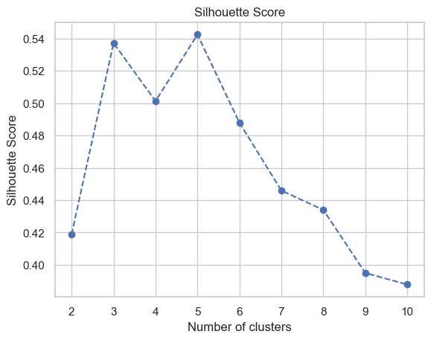
Clustering Evaluation – Silhouette score
Ratio of intra-cluster distances to inter-cluster distances.
Silhouette indices closer to 1 indicate points are well-matched and similar to other points in the cluster.

Slide 3
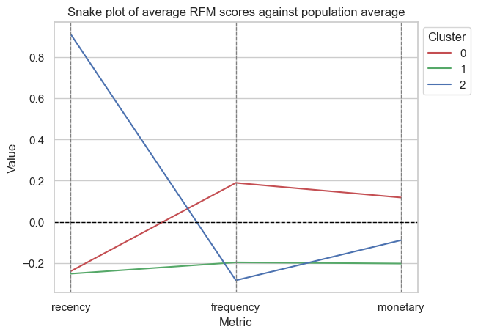
3 Clusters

Slide 4
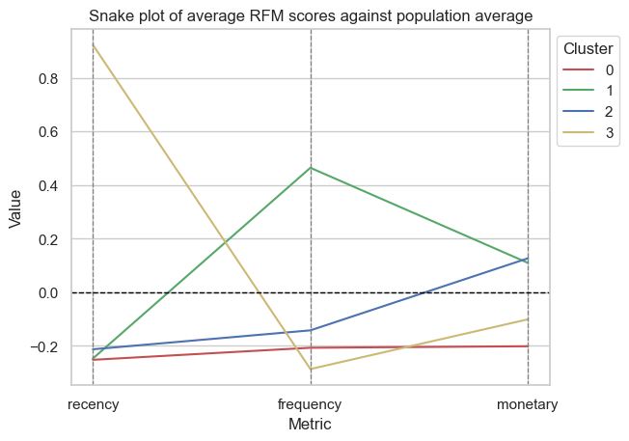
4 Clusters
Only 1 segment of customer (cluster 1) that spends more frequently on average.
This same customer segment has a higher monetary spend compared to the population average as with cluster 2.
Cluster 0 are low spenders who shop infrequently, less recently and lower average spend compared to the population average.
Cluster 3 segment of customers – spent very recently i.e. towards end of the year but less frequently overall and with lower average spend.

Slide 5
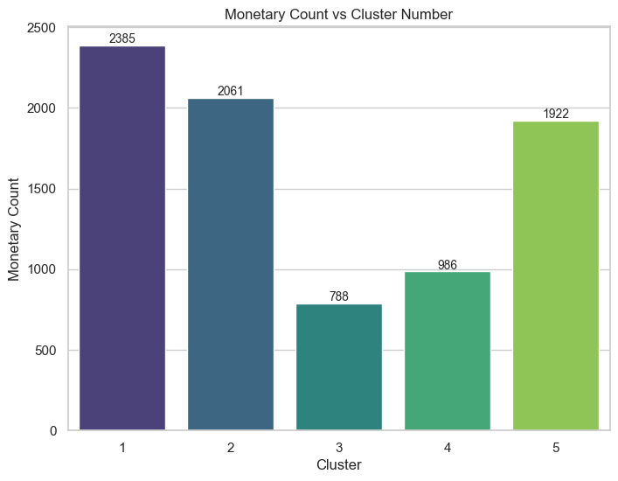
5 Clusters
Most individuals in core clusters 5, 1 and 2.
Minor clusters in 3 and 4.
2 core clusters and 2 minor clusters.

Slide 6
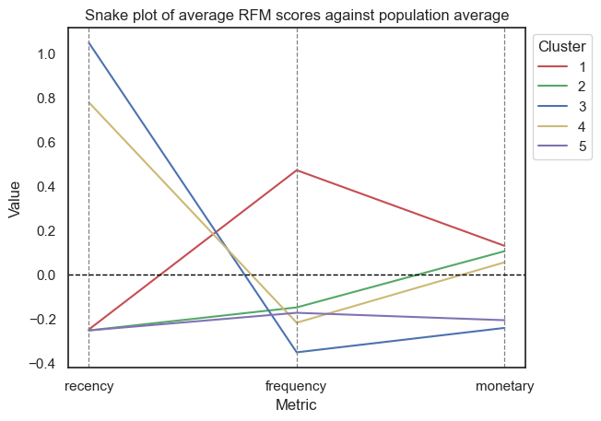
5 Clusters
Major clusters (5,1,2)
5: Below average on all metrics.
1: Above average frequency and monetary spend, low recency.
2: Below average recency and frequency and average/slightly above average monetary spend.
Very large group of people.
Minor clusters (3,4)
4: Below-average frequency, average monetary spend and high recency.
3: Below average frequency, average monetary spend but low recency.
Minor clusters are quite similar apart from the fact that they differ on how recently they have made transactions.

Slide 7
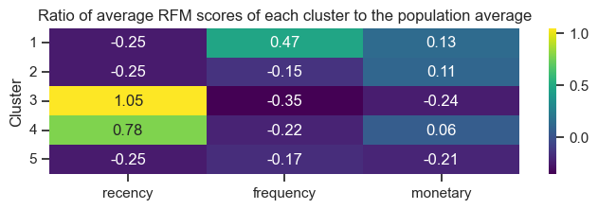
5 Clusters
Low variance around monetary spend.
Many customers are relatively infrequent spenders with one cluster where frequency of transactions is high.
2 Clusters with highly above average recency – spending very close up until the end of the year.

Slide 8
Most frequent spenders – Cluster 1

Slide 9
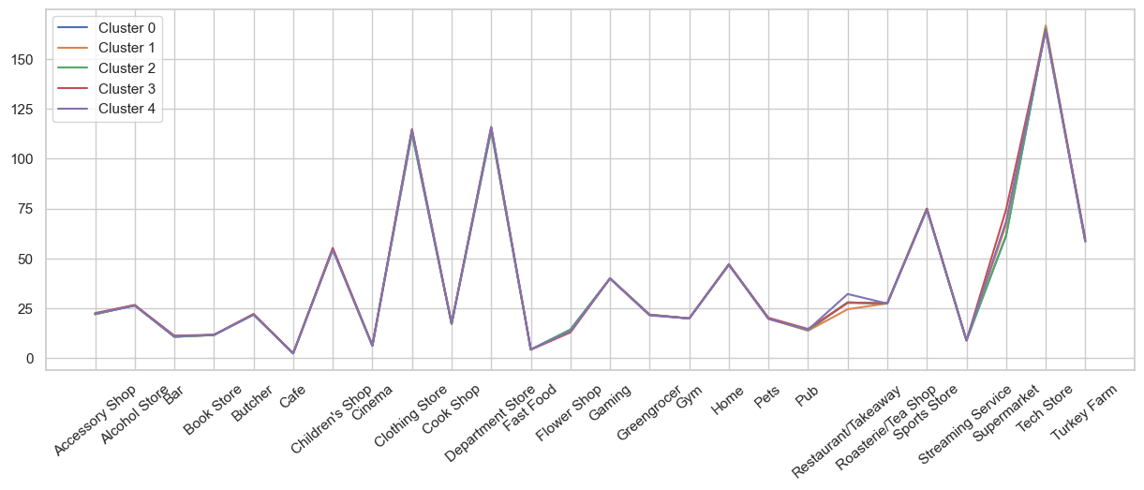
Spending behaviours for each customer segment – 5 clusters

Slide 10
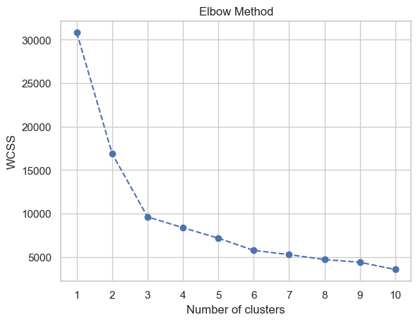
Clustering Evaluation – Elbow plots
Optimal clusters are at the point in which the knee "bends" or in mathemetical terms when the marginal total within sum of squares ("wss") for an additional cluster begins to decrease at a linear rate.
Probably 3 clusters.
Hyperparameters
n_init: ‘Auto’ [Default]
Max_iter = ‘300’ [Default]

Slide 11
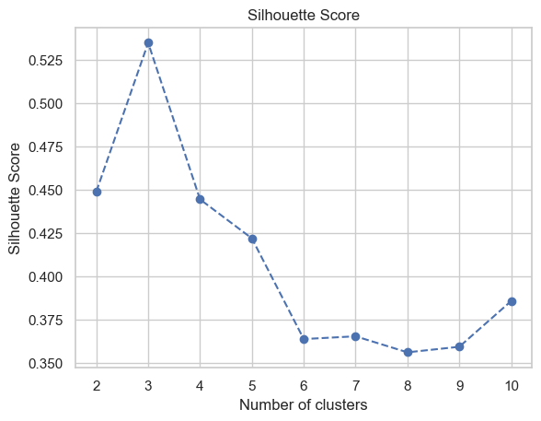
Clustering Evaluation – Silhouette score
Ratio of intra-cluster distances to inter-cluster distances.
Silhouette indices closer to 1 indicate points are well-matched and similar to other points in the cluster.

Slide 12
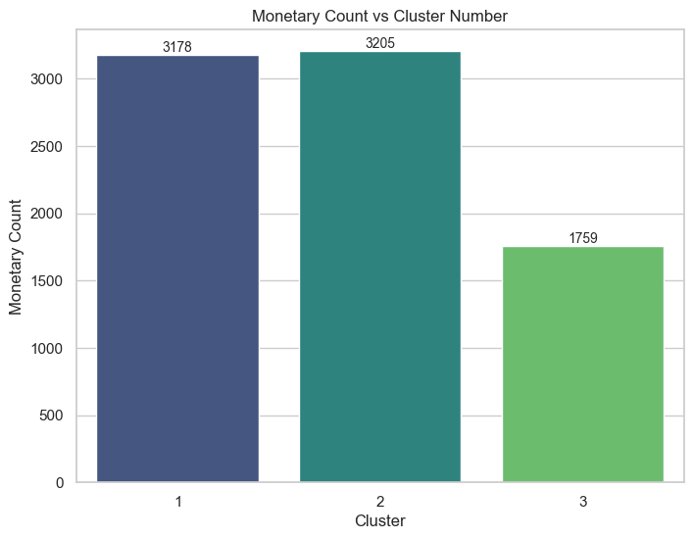
5 Clusters
Most individuals in core clusters 1 and 2.
Minor clusters in 3.
2 core clusters and 1 minor clusters.

Slide 13
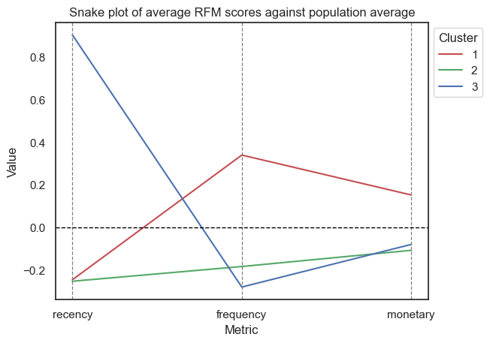
3 Clusters
Major clusters (1,2)
2: Below average on all metrics.
1: Above average frequency and monetary spend, low recency.
Minor clusters (3,4)
3: Below-average frequency, average monetary spend and high recency.
Minor clusters are quite similar apart from the fact that they differ on how recently they have made transactions.

Slide 14
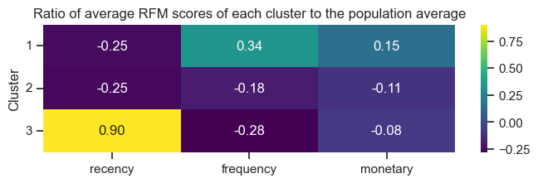
3 Clusters
Low variance around monetary spend.
Many customers are relatively infrequent spenders with one cluster where frequency of transactions is high.
2 Clusters with highly above average recency – spending very close up until the end of the year.

Slide 15
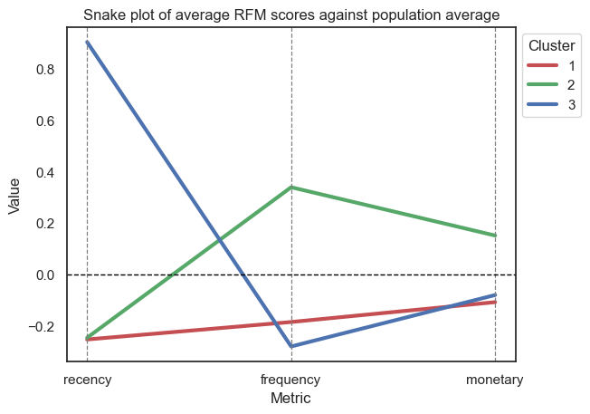

Slide 16
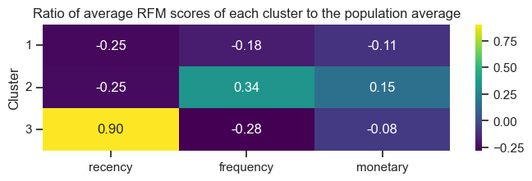

Slide 17
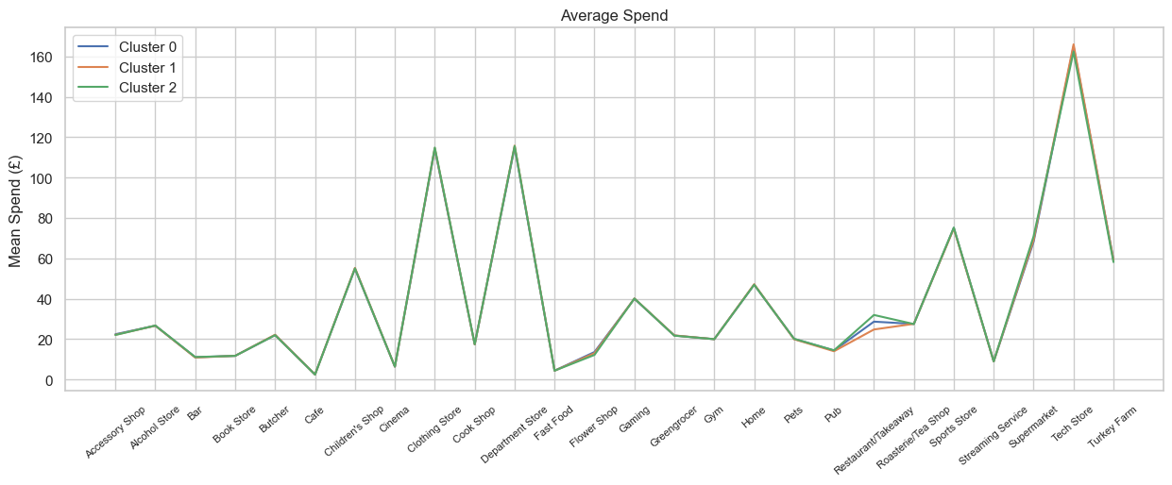

Slide 18
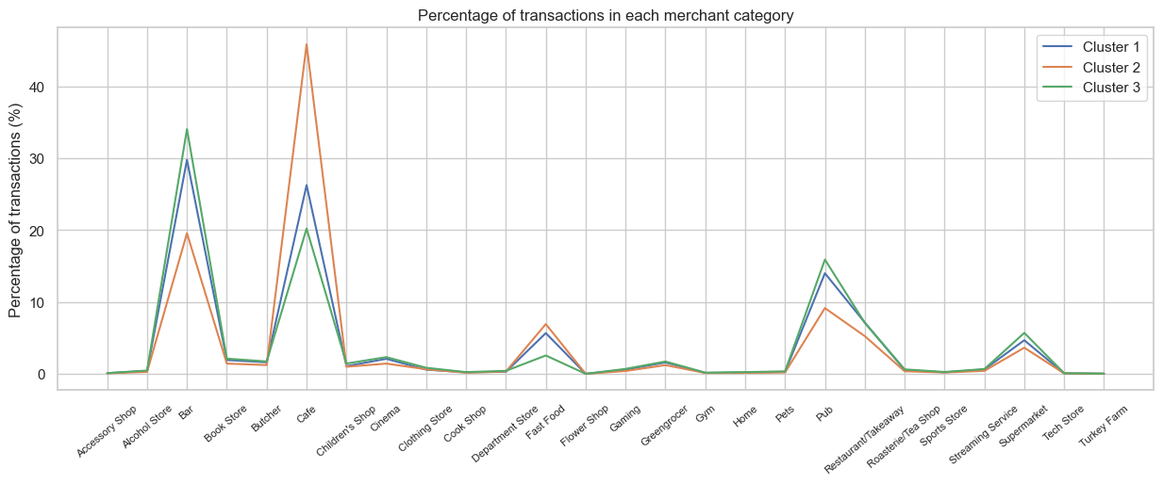

Slide 19
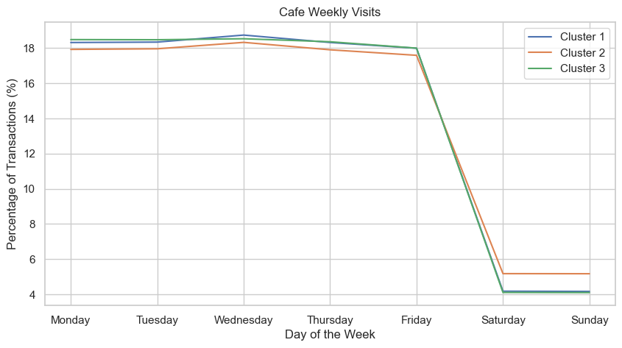

Slide 20
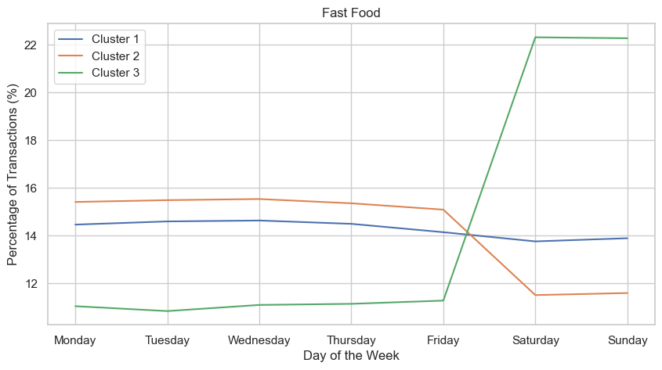

Slide 21
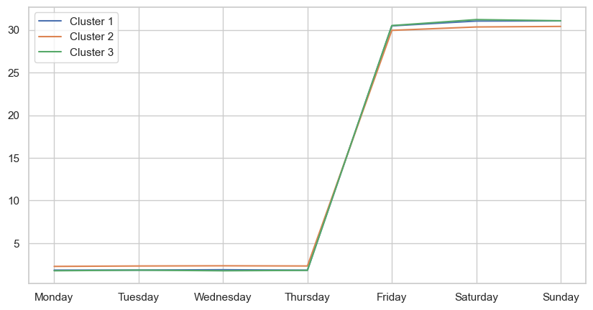

Slide 22
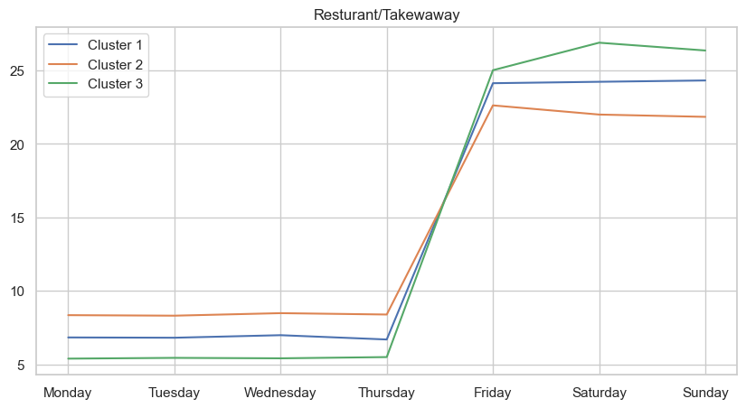

Slide 23
RFM Analysis
Clustering RFM scores was unable to infer in differences per category spend amongst the accounts available → Need another approach to be able to understand consumer behaviour in order to create targeted approaches.
Marketing Recommendations
Lots of young working people get credit cards to improve their to get PCP finance or mortgages.
Can tailor Lloyd’s bank credit card offering with specific cashback schemes aimed cafes/fast food restaurants etc during the week.

Slide 24
Potential issues with this approach
K-Means
Heavily dependant on random initialisation of centroids in order to converge to an optimal solution – k-means++ algorithm solves this.
Assumes clusters belong within a radial distance from a centroid – ‘spherical’ clusters.
Ignores density of clusters. E.g. disparate clusters with a high densities of points may be drawn into a single cluster with a centroid between them.
No mechanism for detecting outliers or uncertainties for points in overlapping clusters.
Have to interpret the clusters numbers and almost manually select the number of clusters.
RFM Analysis
Clustering RFM scores was unable to infer in differences per category spend amongst the accounts available → Need another approach to be able to understand consumer behaviour in order to create targeted approaches.

